Slide 1

GOVERNMENT OF TELANGANA DEPARTMENT OF TECHNICAL EDUCATION
J.N. GOVERNMENT POLYTECHNIC
RAMANATHAPUR, HYDERABAD-500013

Slide 2
Coal Mining Safety Robot Using IoT
Team Member:
21002-EE-090 R. SHASHI KUMAR
21002-EE-114 D. GNANA TEJA
21002-EE-068 B. VENKAT RAJ
21002-EE-113 BHARATH KUMAR
21002-EE-084 MEGHANA
21002-EE-106 SARIKA
Project Guide:
SRI A . KISHORE SIR

Slide 3
ABSTRACT :
The coal mining safety robot is an intelligent security system designed to operate in hazardous environments.
Equipped with sensors , it monitors conditions such as temperature, gas, smoke, and humidity in coal mines, ensuring real-time detection of potential dangers and enhancing overall safety standards.

Slide 4
HAZARDS & RISKS IN COAL MINING :
Coal Dust Inhalation:
Hazard: Inhalation of coal dust.
Risk: Respiratory diseases, such as coal workers' pneumoconiosis (black lung disease), chronic obstructive pulmonary disease (COPD), and other lung disorders.
Gas Emissions:
Hazard: Presence of toxic gases like methane (CH4) and carbon monoxide (CO).
Risk: Explosions, as methane is highly flammable; carbon monoxide poisoning leading to respiratory failure.

Slide 5
Fires and Explosions:
Hazard: Ignition of methane, coal dust, or other flammable materials.
Risk: Serious injuries, fatalities, and damage to mine infrastructure.
To overcome these problems faced by miners , this coal mining robot helps in prevention of these problems.

Slide 6
EXISTING COAL MINING SAFETY ROBOTS :
Mine Rescue Robots: Used for search and rescue operations in case of accidents.
Gas Detection Drones: Employed to monitor gas concentrations in large mining areas.
Wireless Sensor Networks: Deployed for continuous monitoring of environmental parameters.

Slide 7
OBJECTIVES :
Enhance miner safety by detecting and alerting to hazardous conditions in coal mines.
Provide real-time data on environmental parameters like gas concentration, temperature, and humidity.
Improve emergency response capabilities for potential fire incidents or gas leaks inside the mine.

Slide 8
WORKING :
Sensors and Data Collection:
The robot is equipped with a suite of sensors including gas sensors, temperature sensors, smoke detectors, and humidity sensors.
These sensors continuously monitor the environmental conditions within the coal mine.
Real-time Monitoring:
The robot processes the data obtained from the sensors in real-time to assess the levels of gases (CO, CO2, CH4), temperature and humidity.

Slide 9
Threshold Detection:
The system is programmed with predefined threshold values for each parameter. If any of these values exceed the safety limits, it triggers an alert for potential hazards.
Alert System Activation:
In the event of detecting abnormal conditions, the robot initiates an alert system.
For gas detection, it may activate a visual signal, such as a colored light, and an audible alarm like a buzzer to warn nearby miners.

Slide 10
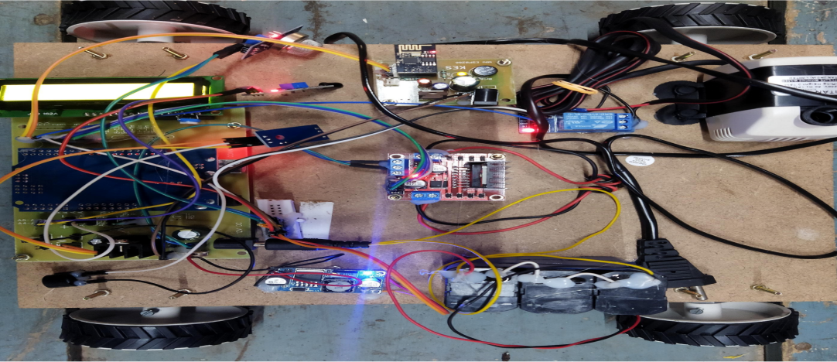
PROTOTYPE :

Slide 11
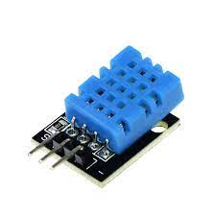
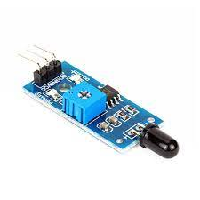
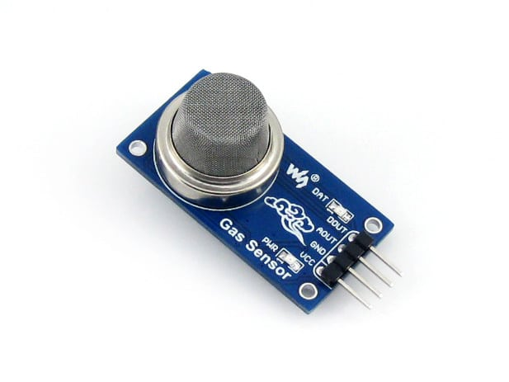
SENSORS USED :
Temperature and Humidity Sensor | DHT11 | Sensor measuring ambient temperature and humidity for environmental monitoring.
Fire Detector Sensor |  | Device sensing flames or high temperatures, triggering alarms for fire safety.
Gas Sensor | MQ2 | A sensor detecting gases like methane and carbon monoxide, alerting in case of hazardous levels.

Slide 12
MATERIALS USED :
HARDWARE :
MQ2 GAS SENSOR
DHT11 TEMPERATURE & HUMIDITY SENSOR
LM2596S BUCK CONVERTER
12V RELAY
ARDUINO
WIFI MODEM ESP826
SOFTWARE :
ARDUINO IDE
EMBEDDED C LANGUAGE

Slide 13
COMPARISON WITH EXISTING ROBOTS :
Comprehensive Monitoring: The proposed robot offers a broader range of environmental monitoring, including gas, temperature and humidity, surpassing some existing systems.
Autonomous Response: The ability of the robot to autonomously respond to emergencies sets it apart from certain robots that may require manual intervention.
Versatility: Unlike specialized robots, this system integrates multiple functionalities, providing a more holistic approach to mine safety.

Slide 14
ADVANTAGES :
Enhanced Safety: Minimizes risks to human miners by detecting and responding to potential dangers.
Real-time Monitoring: Provides immediate data on environmental conditions to prevent accidents.
Autonomous Operation: Reduces the need for human intervention in hazardous situations.
Emergency Response: Enables timely and efficient responses to fire incidents or gas leaks.

Slide 15
FUTURE EXPANSION :
Advanced Gas Analysis:
Integrate advanced gas sensors for more precise identification of specific gases, providing detailed information on the type and concentration levels.
Machine Learning for Predictive Analysis:
Implement machine learning algorithms to analyze historical data and predict potential hazards, enhancing the system's predictive capabilities.

Slide 16
Autonomous Navigation Enhancement:
Upgrade the robot's navigation system to include advanced mapping and path optimization algorithms for more efficient and adaptable exploration.
Integration of Robotic Arm:
Include a robotic arm for additional functionalities, such as sample collection, structural inspections, or even basic repair tasks within the mine.

Slide 17
THANK YOU….

